Slide 1

Parcel Group
Emir Açikgöz
George Ottens
Ismail Böyükşimşek
Laurine Stolpe
Rick Hagenaar
Idrissss Bensaga

Slide 2
Content of today
Quik refresh Project
What did we last week(before autumn break)
Some plots
Feedback from Teachers

Slide 3
Post NL
Co operations with Post NL
Problem of PostNL
What our Goals is for PostNL

Slide 4
What did we last week? (Before break)
Get a better teamwork
Research on Forecasting models
Made Timeseries plots for every customer

Slide 5
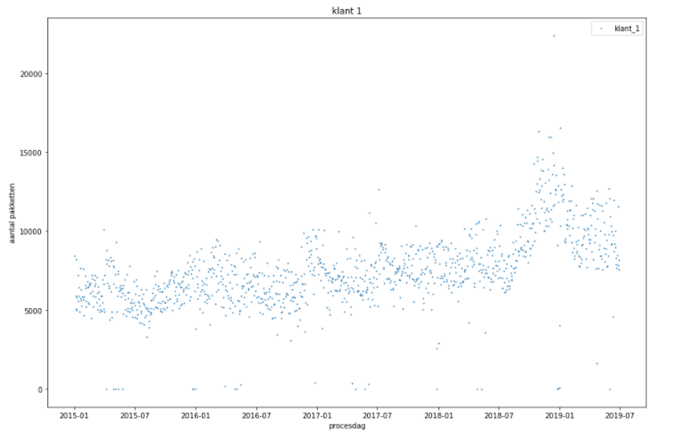
Time serie plots for every customer Customer 1

Slide 6
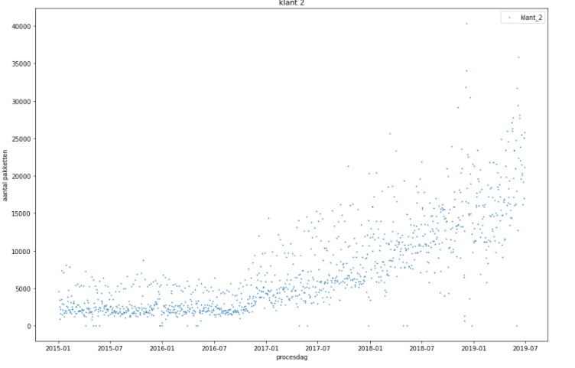
Customer 2

Slide 7
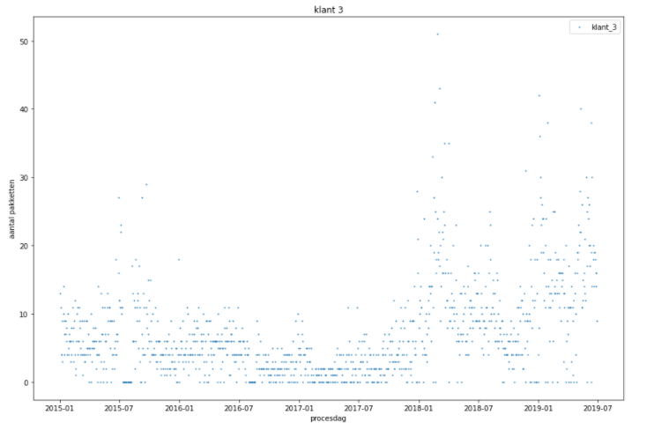
Customer 3

Slide 8
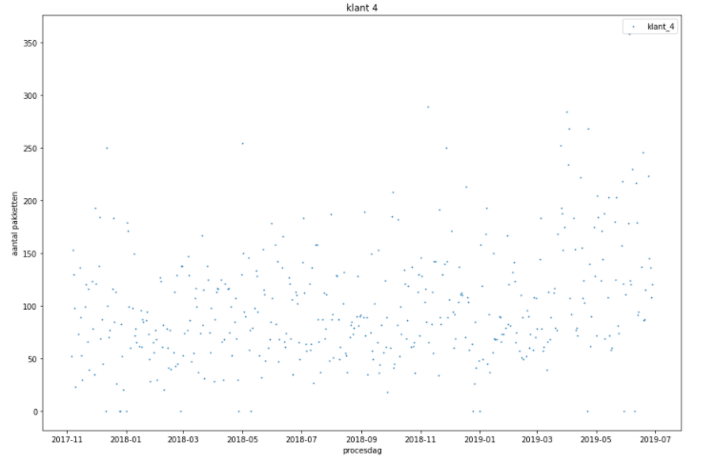
Customer 4

Slide 9
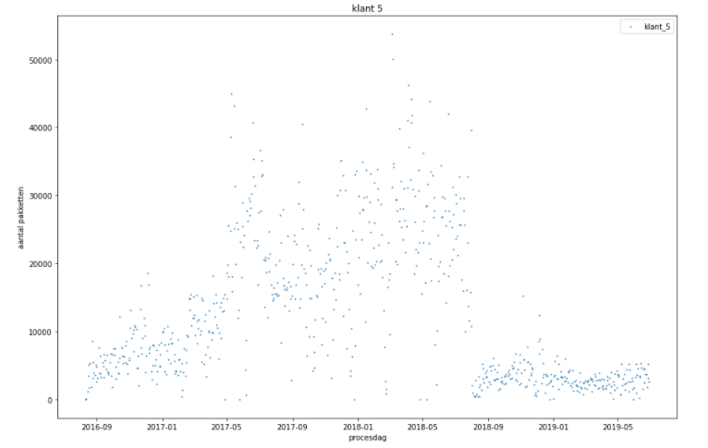
Customer 5

Slide 10
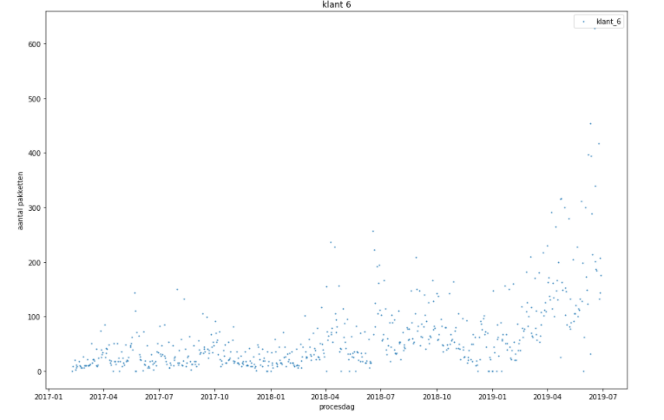
Customer 6

Slide 11
Feedback time for teachers

